Slide 1
A Study of Security Mechanism using Face Detection, Attribute Based Encryption and Deep Learning in Cloud and IoT.
Presenter-Sampath Yelchuri

Slide 2

What is Security ?
The term “Security” is defined as the process of protecting data or information from unauthorized access which is present either in the form of physical or digital manner.

Slide 3
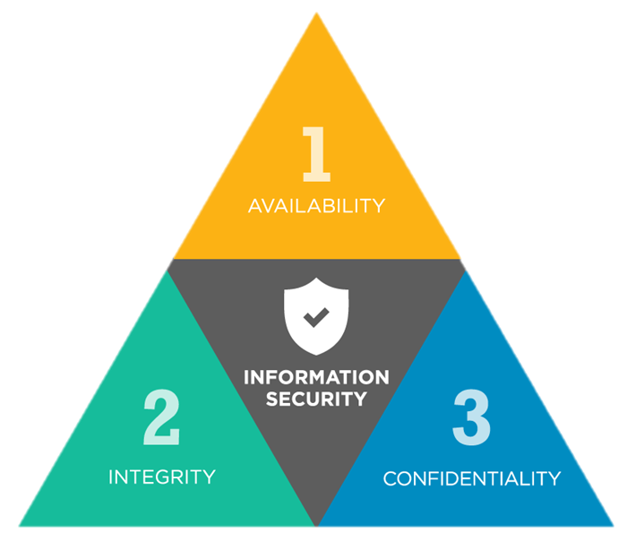
Why Security ?
The following are the three reasons for maintaining security :
Confidentiality.
Integrity.
Availability.

Slide 4


Introduction
In today’s world, use of Cloud and Internet of Things (IoT) has been drastically increased.
Day by day, the amount of data that is being gathered or consumed is also getting increased in cloud and IoT devices.

Slide 5
Intro (Cont.)
As there is a huge increase in the amount of data, security plays a crucial role in maintaining user’s privacy.
For any organization or service, security and privacy of the user is a challenging task.

Slide 6
Research Question
How can we develop a security approach which can maintain both authenticity and data security in cloud and Internet of Things (IoT) by integrating new and trending technologies ?

Slide 7
Proposed Idea
Encoding and Decoding of data is not only the main key aspect of enhancing security but authentication of user(s) play a crucial role.
Here we are introducing a new approach to enhance not only the security but also the authentication system as well.
This approach concentrates on the following two aspects of security and privacy:
Authenticity of user(s).
Encryption of Data using ABE.

Slide 8
Proposed Idea
The main idea here is to provide a 3-Tier Security system.
The following are the 3 essential components which are used in this approach :
Face Detections System [Pawar V. P . et al ]
Attribute Based Encryption (ABE)
Convolutional Neural Networks (Covnets).

Slide 9
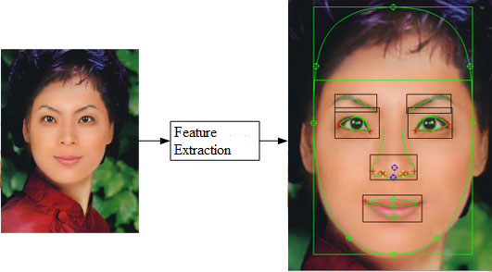
Proposed Idea (Cont.)
Face Detection System (FDS): This mechanism was proposed by ‘Pawar V. P.’ and ‘A. A. Pawle’ which is used as the first phase for providing authentication.
Initially, with the help of this system, we extract the face features or properties of user(s) and maintained them in a server for authentication purpose.

Slide 10
Proposed Idea (Cont.)
Attribute Based Encryption (ABE): This is an asymmetric functional encryption scheme which uses private/public keys for encoding and decoding the information.
Here, in the second phase, with the use of the face features or properties that are gathered from FDS system are used as attributes or keys for encryption and decryption purpose.

Slide 11
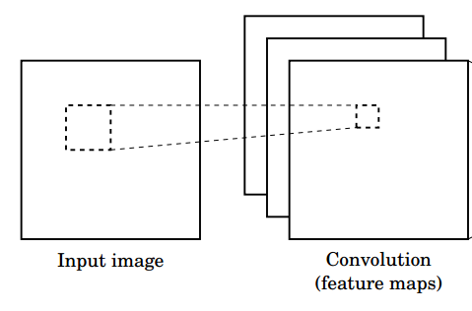
Proposed Idea (Cont.)
Convolutional Neural Networks (Covnets): It is a concept which is introduced in Deep Learning which helps in classifying and analysing image(s) into different layers.
In the final phase, with the help of Covnets, all the face features that are captured by the FDS system are classified into 3 layers.

Slide 12
Approach
The following steps represents the way this approach works:
Step 1: The first phase is to provide the user(s) face to the FDS for the purpose of authentication.
Step 2: If the user(s) is an existing member(s) of the cloud, then check for the authorization else make a new registration.
User Face Input
FDS Extract
Features
Check Features
Yes
No
Authorize
Register

Slide 13
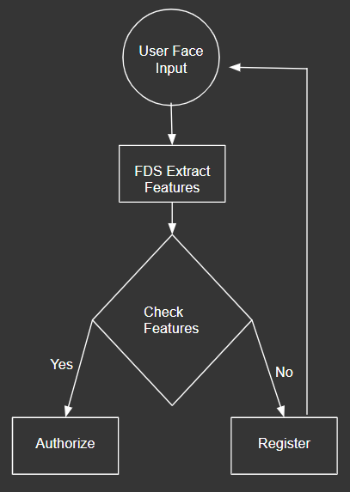
Approach (Cont.)
Step 3: If the user(s) gets authorization from the FDS, then user(s) data is now encrypted using ABE with the help of features extracted by the FDS and then stores in the cloud.
Step 4: For Registering the user along with the face features we make use of user(s) personal details like mobile number or email id to make user(s) authorized.
Covnets
Server
ABE
Cloud

Slide 14
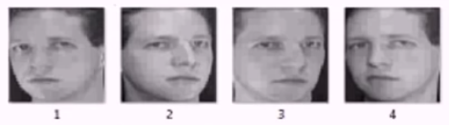
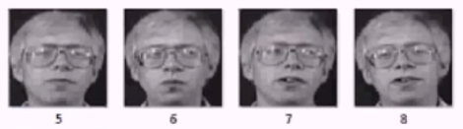
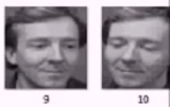
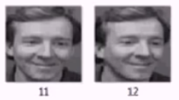
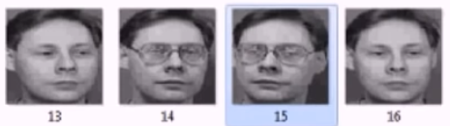
Experiment Results
Initially, we have considered a Server which has the features of four persons by registering.
We have considered 16 images as our training data set for all the four persons whose features are stored in the server.
All the 16 images are classified into 4 classes where each class consists of 4 images the same person at inclined positions.
Class-1
Class-2
Class-3
Class-4

Slide 15
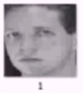
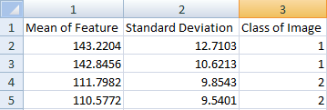
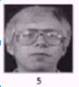
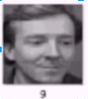
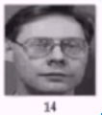
Experiment Results (Cont.)
Trained Data Set

Slide 16
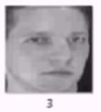
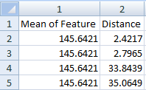
Experiment Results (Cont.)
Test Data
Extract Features (FDS)
Class - 1

Slide 17

Advantages
3-Tier Security System.
Unique features like face features are used for encryption and decryption.
Use of Covnets for multi-layer security checks.

Slide 18

Anticipated Risks
Capturing high resolution image of user.
It becomes difficult to encrypt and decrypt data without the features of the user(s).
Sometimes there might be some cases where the mean value of the two similar images may approximately be the same and the difference remains the same. In this case it would be difficult for the FDS system to find the class for the input image.

Slide 19
Conclusion
With the help of modern and developing technologies like Face Detection, Attribute Based Encryption (ABE) and Covnets, we can provide an efficient security and privacy mechanisms by integrating technologies. This approach can also be carry forwarded where the system can learn themselves to maintain privacy for user(s) data on cloud and IoT.

Slide 20
Future Work
Coming down the line, we have to use the features of user(s) which are store in the server to encrypt the data and push the data to the cloud.
Using the Convolutional Neural Networks (Covnets) we have to increase the efficiency and training of the FDS.

Slide 21
Questions ?

